Slide 2
April Announcements
Seeking Additional SIG’s
Capture the Flag Event – Hold the Date November 11 & 12
GoCyber Collective Business Cards for Distribution

Slide 3
Huber Heights Ransomware Attack
Response and Recommendations
Presented to First Suburbs on January 24, 2024

Slide 4
Introductions
Richard Dzik, City Manager, Huber Heights, Ohio
Shawn Waldman, CEO, Secure Cyber Defense

Slide 5
Background
New City Manager hired September 11, 2023.
Huber Heights IT Director resigned effective November 3, 2023.
Prior to his departure IT Director had completed Phase I of virtual local area network (VLAN) deployment.
Phase II would have secured and isolated these VLANs, but was not yet been completed.
City was preparing for a cybersecurity review and upgrade.
From the beginning of the incident the ability for public safety to operate was unaffected.

Slide 6
Timeline – Sunday, November 12, 2023
8:13am Dispatch Reports IT Issues
HHIT Responds and Identifies Ransomware
Dispatchers Relocated to RDC
12:00pm City Manager Notified, Insurance Carrier Notified
3:00pm SCD Onsite and Assists City in Quarantining Systems
SCD Notifies State and Federal Officials
7:00pm Division Heads are Briefed
7:55pm City Council Briefed in Emergency Session
10:00pm Situation Mitigated – Systems Disconnected

Slide 7
Timeline – Monday, November 13, 2023
Insurance Carrier Engages Outside Legal, Forensic Investigation and Threat Negotiation Vendors
City Suspends all Late Fees and Utility Shut-offs. Critical Public Safety Services Unaffected.
4:00pm Kickoff Call Scheduled with Vendors
6:00pm Council Holds Regular Session, Passes Emergency Resolution, Authorizes City Manager up to $350,000 Spending Authority
By EOD SCD had Validated all City Backups and Assessed Impacted Systems
City Begins Planning for Continuity of Government and Temporary Operations

Slide 8
Timeline – Tuesday, November 14, 2023
City Begins Purchasing Clean Devices to Restore Operations
Upgraded Security Equipment (Firewalls) Ordered
SCD is Advised on Evidence Collection from Forensic Firm and Collects Evidence from Tuesday to Thursday
City Receives 20 LTE Devices from Verizon Crisis Response
Zoning, Permitting, and Code Enforcement Brought Online (Cloud)

Slide 9
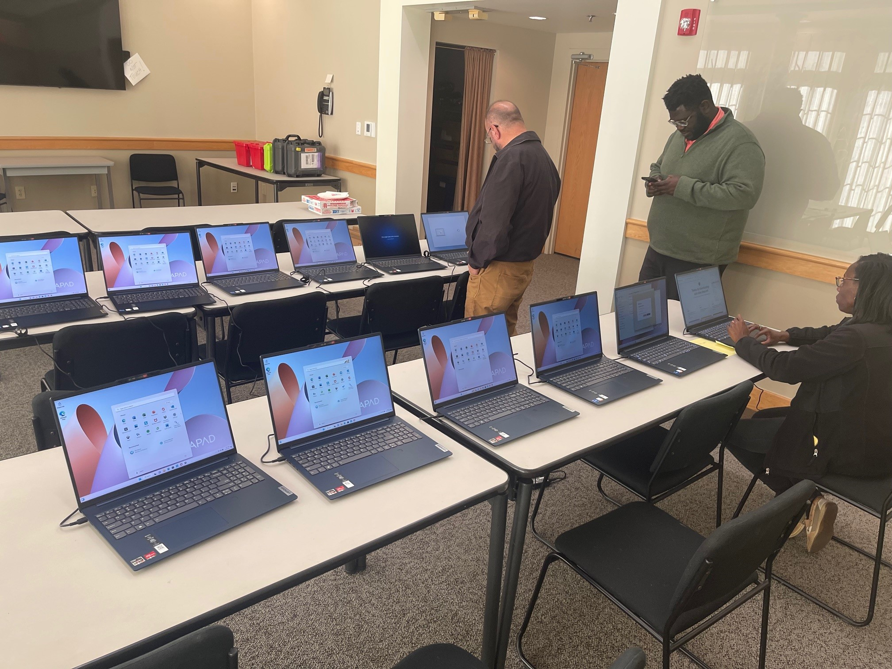
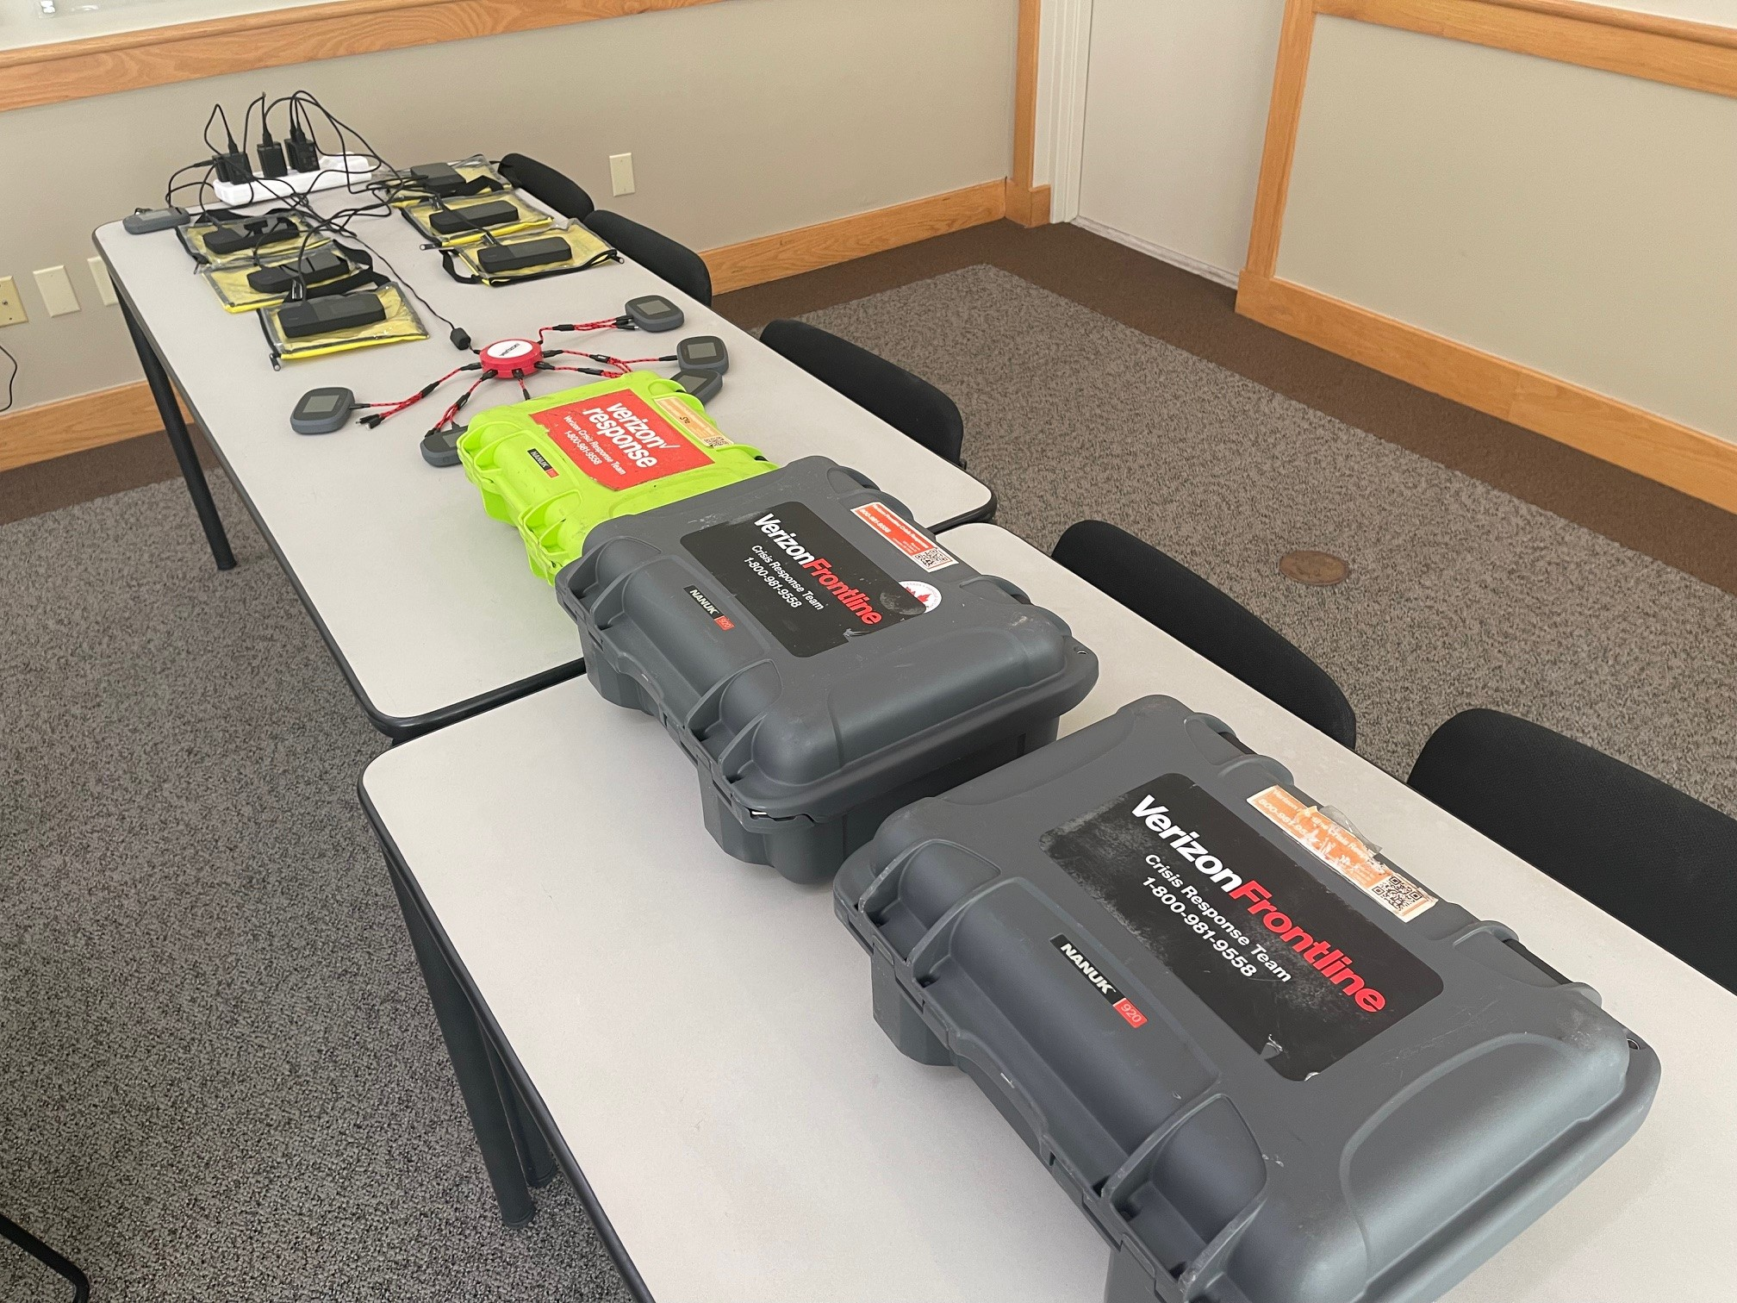

Slide 10
Timeline – Wednesday, November 15, 2023
Ability to Access and Distribute Police Records Restored with Montgomery County
Work with CMI/Civica to Deploy Finance Software in a Cloud Environment
Work with Motorola to Begin Storing Bodycam Data in a Cloud Environment (critical)
SCD Continued Forensic Evidence Collection
Ability to Receive Online Payments Restored

Slide 11
Thursday, November 16, 2023
New Firewalls Delivered
Evidence Collection Complete and Investigation Begins
Building New Environment for Finance Programs
Most New Hardware Upgrades Deployed
Finance Programs Operational by EOD

Slide 12
Friday, November 17, 2023
New Firewall Installation Complete
Press Conference Held at City Hall
Next Week Planning Includes EDR Installation and Reimaging of City Devices
All Backups Validated
Next Step: Begin complete rebuild of the City’s IT Infrastructure
Next Step: Implement 24/7 Monitoring

Slide 13
Items of Note
All vendors and city personnel scheduled daily morning status calls for the first 3 weeks.
AT&T/FirstNet operates a Crisis Response Program as well.
Store bought computer equipment will lack some functionality versus enterprise devices (i.e. Home Edition).
At some point in the first week it was identified that HHIT had previously connected the City’s water plant to the City’s unsecured network. This information was not shared publicly.

Slide 14
Staff Communications
Weekly Staff meetings were focused on attack, set up additional staff meetings as necessary.
Email and phone systems were cleared in first day making communications easier.
Staff was advised to operate as closely to business as usual as possible. Advised to catch up on things not requiring technology (filing, etc.).
Customer service was prioritized due to delays and difficulties for customers.

Slide 15
Public Information
City started early by issuing a press release about the incident.
City provided daily updates via the City website.
City provided numerous print, radio and tv interviews.
Culminated in Friday press conference.
Ongoing updates until resolved.
Examples of all of this are provided in the appendix.

Slide 16
Media Recommendations
Provide as much information as you can securely provide.
Leave out vendors
Leave out details about IT infrastructure
Leave out issues that might create panic unnecessarily
Don’t make promises you can’t keep.
Okay to say maybe, we hope, or that the timeline isn’t certain
If anything under promise and overperform
Fully understanding the extent of personal information loss will take a long time…make sure everyone knows that from the beginning.
Video 1 (1:40)
Video 2 (1:10)

Slide 17
Week Two – Thanksgiving Week
Short week – priority was to bring all crucial systems up for the following week.
Threat negotiator attempted to contact threat actor at the end of last week. All attempts to work with threat actor were unsuccessful due to inaccurate information from the threat actor.
Think about this – What would happen if you had no backups and couldn’t reach the threat actor to negotiate?

Slide 18
Week Three and After
Worked closely with SCD to facilitate the recovery of City systems.
Continue to brief the media on progress
Continue to work with insurance to figure who/exactly was impacted by the incident.

Slide 19
Ongoing
Began cleaning and restoring devices.
Obtained stolen data from dark web.
Data mining company reviewed 198GB of stolen data.
City expects report on Friday, January 26, 2024.
Insurance will make necessary notifications and provide credit monitoring.

Slide 20
Behind the Scenes – Secure Cyber Defense
Contacted Sunday afternoon, arrived around 4pm
Myself (Victim Advocate) and Senior Cyber Forensic Investigator – We act very much as first responders
Assess the scene, contain the incident (attempt to stop any bleeding), brief necessary resources, involve Federal LE, design the plan to move forward, assess additional staff required
Brief council, senior staff, assist with press releases and talk about continuity of Government
We know going in that an incident of this size is going to be many months of almost around the clock work

Slide 21
Behind the Scenes – Secure Cyber Defense
Monday – Continue with isolation and containment
There is a lot to learn, we don’t know the network, the applications etc. This has to be learned very quickly.
While we wait for insurance, we assess the backups and possible recovery paths. Continue to assess damage and what’s been impacted
Assessed the water plant (more on this later)
Tuesday – Insurance call, forensic gathering starts. This will end up lasting almost 5 days. At this point, PR folks just now show up, law firm has been secured. Daily calls start happening.

Slide 22
Behind the Scenes – Secure Cyber Defense
Water Plant – Huber outsources the operation of water to Veolia. Waste water is handled through Tri-Cities.
The Water Plant had already been isolated off the network prior to our arrival
We took a forensic capture of the 2 Human Management Interfaces (HMI’s) and found they were compromised by the threat actor
No water production was impacted, the plant operated normally with 24/7/365 coverage due to no remote access
Still working to recover fully the water plant, switch to updated components, new HMI’s

Slide 23
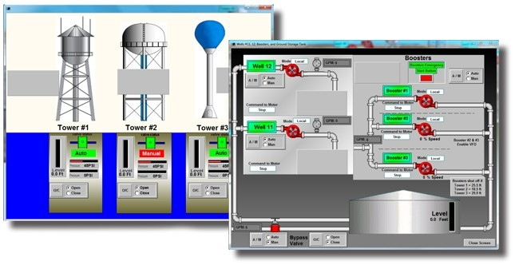

Slide 24
Behind the Scenes – Secure Cyber Defense
At the same time as teams are gathering forensics, we’re replacing the City firewall and installing new Endpoint Detection and Response. This connects the City to our 24/7/365 Cyber monitoring center in Moraine. This helps tremendously with long term recovery and places the City under constant monitoring.
Moved many city resources to the cloud (Office365 wasn’t impacted)
Developed a recovery plan to rebuild authentication servers, contact vendors to rebuild key systems. Lots of work gathering vendors and getting them to move quickly. Getting updated documentation.

Slide 25
Behind the Scenes – Secure Cyber Defense
Continue to fix network overhaul that was stopped mid-stream. At the same time, design an entirely new network with proper segmentation.
The City’s desire was to outsource Cyber and Network to SCD for the immediate future.
About 2 weeks before Christmas we brought up the legacy network slowly and also helped facilitate the bringing back of the police dispatch center from the RDC.
SCD placed an interim IT Director to help manage current staff and prioritize and facilitate day to day recovery tasks.

Slide 26
Behind the Scenes – Secure Cyber Defense
AS OF TODAY – New networking equipment has arrived and we’re beginning the plan to install the new updated equipment with the new design
We’re working with multiple Water Plant vendors to assist with the full recovery and ongoing protection of the plant itself.
Installing new remote water plant resource communication equipment

Slide 27
Lessons Learned
Prioritize cybersecurity and secure infrastructure.
Ongoing, regular training with all staff about cybersecurity and phishing.
Bring in 3rd party assistance early, preplan a vendor.
Contact insurance early.
Start issuing public information early.
Invest heavily in IT infrastructure and staff.
Institute multiple means for backup of files (onsite, cloud)

Slide 28
More Lessons Learned
Implement imaging and logs of server systems.
Do not delete anything prior to forensic investigation, simply quarantine systems.

Slide 29
Questions?

Slide 30
Appendix – Media Package
Initial Press Release sent on 11/12/2023 at 11:00 p.m.
Website News Flash
Facebook Post
Started list of FAQ’s to address resident concerns on social media

Slide 31
Appendix – Media Package
Used Website Newsflash for Daily 2pm Updates 11/13/23 - 11/17/23
Posted until 11/22/23.
11/27/23 - Issued media release update
12/4/23 notice of closure for Water Division offices 12/5 - 12/7 posted on website and social media
12/19/23 notice of delay/issues with water billing posted on website and social media
Posted until 1/1/24

Slide 32
Appendix – Media Package
Coverage from media outlets:
https://www.daytondailynews.com/local/huber-heights-city-government-hit-by-ransomware-cyber-attack/4HAJD66AGJFTDDYSU4IQS3AJGY/
https://www.whio.com/news/local/local-city-experiences-ransomware-attack-what-residents-should-know/NCBLY5FXTBFIRPMT2VDY3DBCSM/
https://news.yahoo.com/local-city-experiences-ransomware-attack-045010413.html
https://dayton247now.com/news/local/huber-heights-investigating-following-ransomware-attack
https://www.energyportal.eu/news/several-services-impacted-after-ransomware-attack-hits-local-city/483352/#gsc.tab=0
https://dayton247now.com/news/local/several-city-services-impacted-after-cyberattack-on-huber-heights

Slide 33
Appendix – Media Package
Coverage from media outlets:
https://www.wdtn.com/as-seen-on-2-news/what-is-ransomware-and-how-can-you-protect-yourself-from-it/
https://www.whio.com/news/local/really-frustrating-city-official-explains-how-recent-cyber-attack-impacts-residents/KPG5QT5HRFBWLPGAXPRJCG772Y/?fbclid=IwAR3utfWnfOjAPc8cqEtG1ToNxlyyZr8r09Fi4TAG09hapE7siO8F-pjBiHc
https://www.wyso.org/government-politics-news/2023-11-13/huber-heights-city-offices-attacked-by-ransomware-some-city-services-affected
https://therecord.media/huber-heights-ohio-ransomware-attack
https://www.cybersecurity-insiders.com/ransomware-attack-on-huber-heights-drives-it-into-emergency/

Slide 34
Appendix – Media Package
Coverage from media outlets:
https://www.wdtn.com/news/local-news/huber-heights-declares-state-of-emergency-following-cyberattack/
https://www.whio.com/news/local/local-city-declares-state-emergency-after-cyber-attack-use-taxpayer-money-investigate/D4FZZXWYGZDEHFEUQRHMZHSJUA/
https://www.energyportal.eu/news/local-city-declares-state-of-emergency-after-cyber-attack-to-use-taxpayer-money-to-investigate/485724/#gsc.tab=0
https://news.yahoo.com/huber-heights-declares-state-emergency-030627055.html
https://www.wyso.org/news/2023-11-14/huber-heights-in-state-of-emergency-after-ransomware-attack

Slide 35
Appendix – Media Package
Coverage from media outlets:
https://www.govtech.com/security/huber-heights-ohio-suffers-ransomware-attack-on-systems
https://www.daytondailynews.com/local/some-huber-heights-data-systems-remain-shut-down-following-cyber-attack/VCUJVRJKOBGIHI6JCFZOPRUWYQ/
https://www.scmagazine.com/brief/ohio-city-disrupted-by-ransomware-attack
https://www.whio.com/news/local/first-forensic-evidence-collected-after-local-ransomware-attack-city/IL74XLGSUBCWNGH75PQM42OILQ/
https://www.wdtn.com/video/huber-heights-declares-state-of-emergency-following-cyberattack/9170107/
https://www.daytondailynews.com/local/huber-heights-it-director-resigned-9-days-before-cyber-attack/NJMUSBJMEBH65MZYTNRVFUMED4/

Slide 36
Appendix – Media Package
Coverage from media outlets:
https://www.whio.com/news/local/local-city-still-working-restore-services-after-ransomware-attack/3LTP4I63VBEDPKNA4JVLCITZAA/
https://www.whio.com/news/local/local-citys-it-director-resigned-9-days-before-ransomware-attack/YI24B43E2FHWLOEJNZ3RSBOGQU/
https://www.whio.com/news/local/city-huber-heights-hold-news-conference-today-following-ransomware-attack/RELVDFUENBDGVPNMGWGNVNSYQQ/
https://www.daytondailynews.com/local/just-in-kettering-to-consider-freeze-on-recreational-marijuana-businesses/V6N2ANRDXVFFTBJOTDCCSUWVGI/
https://www.wdtn.com/news/local-news/huber-heights-officials-to-give-update-after-cyberattack/
https://www.wyso.org/government-politics-news/2023-11-20/huber-heights-services-temporarily-restored-fbi-investigating-ransomware-attack

Slide 37
Appendix – Media Package
Coverage from media outlets:
https://www.daytondailynews.com/local/huber-heights-still-doesnt-know-if-resident-data-was-hit-by-ransomware-attack/FKA2EEW5PNAJXDLIEQCDEXYEF4/
https://www.daytondailynews.com/local/huber-heights-able-to-process-city-payroll-but-still-solving-cyber-attack-issues/JITB7Z6YPJF2RPH3DCFN75FHSQ/
https://www.wyso.org/courts-crime-news-ohio/2023-11-28/huber-heights-ransomware-update-income-tax-online-water-billing-system-repairs-almost-completed
https://miamivalleytoday.com/huber-heights-gives-update-on-ransomware-attack/
https://www.whio.com/news/huber-heights-provides-update-cyber-attack-says-some-services-restored/16ee71ee-03d1-4574-a470-d85400f00dfe/

Slide 38
Appendix – Media Package
Coverage from media outlets:
https://news.yahoo.com/huber-heights-provides-upate-cyber-213026879.html
https://www.daytondailynews.com/local/status-of-huber-heights-residents-personal-data-unknown-as-investigation-continues-into-cyberattack/2TSA2IRTUNHMZG7YVJQRMPTTJY/
https://www.daytondailynews.com/local/huber-heights-cyber-attack-city-functions-restored-350000-spent-personal-data-issue-in-limbo/M6VB74BTTFGRPKLWNX5K4KOS2Y/
https://www.whio.com/news/local/local-citys-functions-restored-350k-used-handle-ransomware-attack/UDJAU23EJNDBRDMXRUQX7WWNUM/
https://www.daytondailynews.com/local/huber-heights-cyber-attack-cost-hits-800k-resident-data-vulnerability-unclear/4GU6DAB7BVF3FITNGIGG7FUYUM/

Slide 39
April Threat Briefing

Slide 40
Information
Feel free to email us at Admin@gocybercollective.org.
If you have a suggestion on meeting topics, special interest groups, breakfast menu, or anything else we want to hear from you.
You can register and download past presentations from the website.
GoCyberCollective.org

Slide 41
Event Sponsors

