Slide 2
October Announcements
GCC Growth Very Active Previous Month
Community Outreach Projects Underway
November 4th – Threat Intelligence
November 18th – AI For Management
November 18th – Governor Visit/Ribbon Cutting

Slide 3
October Announcements – (cont’d)
November 18-19 – Capture the Flag
December 16th – Christmas Gathering at Yankee Trace
GoCyber Collective Business Cards for Distribution
GoCyber Signal Group
GoCyber Slack Communication

Slide 4
Cybersecurity Capabilities
Professor Mike Libassi
Sinclair Community College
Notes:
Eric

Slide 5
Agenda
Cybersecurity Degree Programs.
NCAE-CD Accreditation & Industry Certification Alignment.
University Transfer Partnerships.
Grants & National Leadership.
Sticker Heist and demo
Notes:
Eric

Slide 6
Cybersecurity Degree Programs
Cybersecurity Degree Programs focus:
Cyber Defense (Secure System Administration)
Cyber Crime & Digital Forensics (Cyber Investigation Technology)
One-year Technical Certificates
Short-term Technical Certificates
Notes:
Eric

Slide 7
NCAE-CD Accreditation
Sinclair is a National Center of Academic Excellence in Cyber Defense (NCAE-CD)
Through NSA and CISA.
Only 467 institutions hold this title.

Slide 8
Industry Certification Alignment
CompTIA Security+
CompTIA Pen Test+
CompTIA Net+
CompTIA A+
Cisco CCNA
EC-Council Certified Ethical Hacker
EC-Council: Certified Hacking Forensics Investigator (DoD recognized)

Slide 9
University Transfer Partnerships
Our cyber programs transfer seamlessly to:
Wright State University
University of Dayton
University of Cincinnati
Franklin University
WGU

Slide 10
CyAD Conference
Cross-Disciplinary Cybersecurity Collaboration
Kyle Jones helped launch CyAD (Cybersecurity Across Disciplines).
This conference focuses on the intersection of cybersecurity, manufacturing, and IoT and promotes collaboration across these fields.

Slide 11
Grants & National Leadership
NSF Leadership:
Kyle Jones serves as Co-PI of the NSF’s National Cybersecurity Training and Education Center (NCyTE).
CyberCorps® SFS:
Sinclair was a pioneer in this program, one of the first community colleges to offer it to students, allowing them to serve in cybersecurity roles post-graduation.
Jumpstart into Cyber (NSF Grant):
This grant, highlighted by the White House, helps bring diverse students into cybersecurity careers.
Sticker Heist (NSF Grant):
A gamified learning experience to teach cybersecurity skills through an interactive puzzle box.

Slide 12
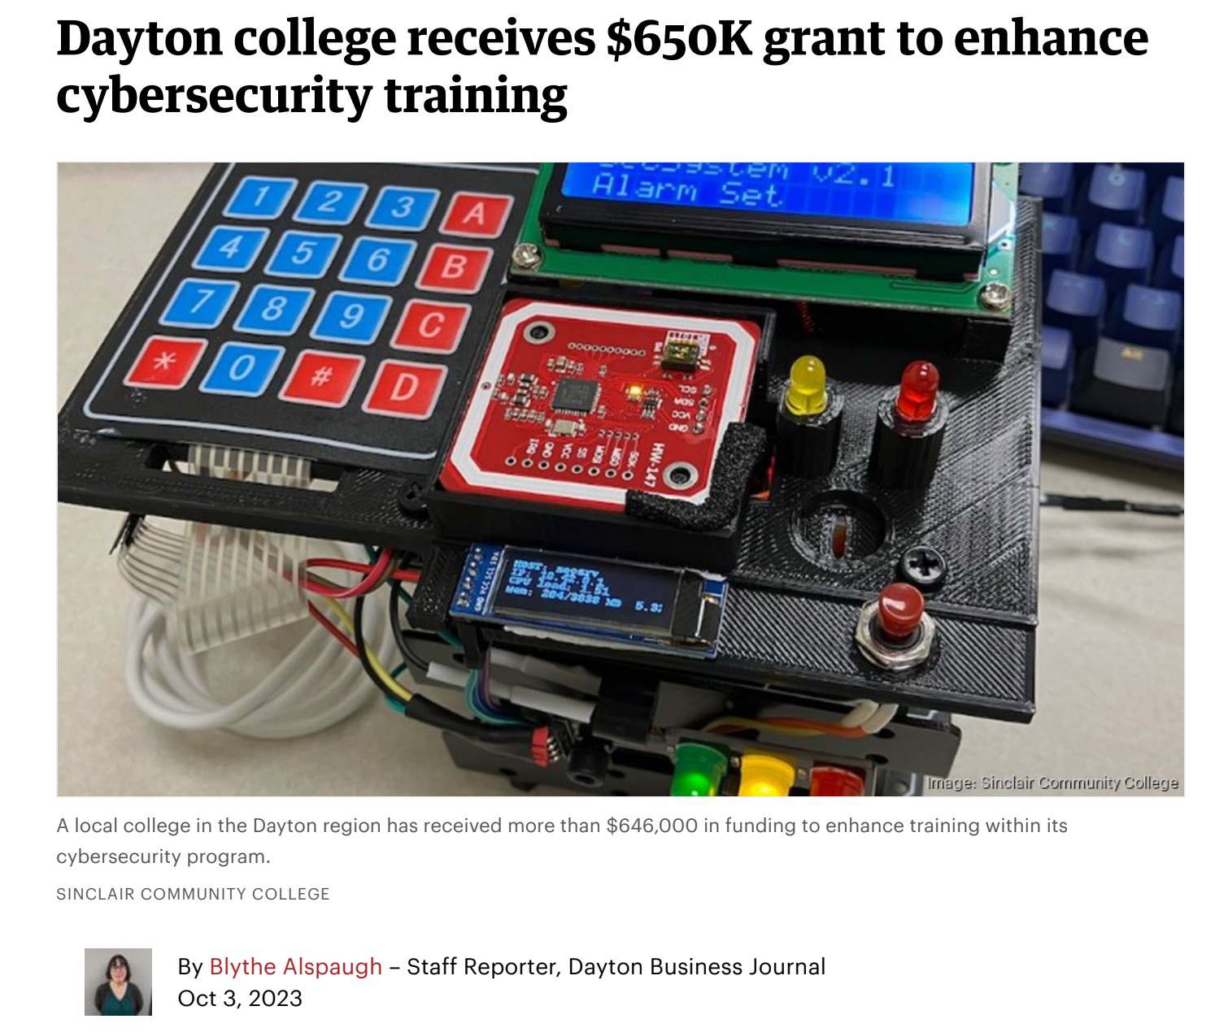

Slide 13
News Story

Slide 14
What is Sticker Heist

Slide 15
What is Sticker heist
Sticker Heist is a cybersecurity challenge that encourages teamwork, communication, while teaching cybersecurity principles.
Self-contained portable security system protecting a locked box of laptop stickers.
However, the system is not 100% secure.
There are several vulnerabilities that challenges students while learning, or practicing, cybersecurity.
Notes:
Mike

Slide 16
Design Thoughts
The hands-on heist gives a unique way to learn and practice cybersecurity with:
Analyzing how system works.
Flexible thinking.
Creative Problem solving.
Communicating ideas and collaboration.
Notes:
To play with something is to explore its possibilities and test its limits. These are some of the primary tenets of cybersecurity, specifically pentesting.

Slide 17
Design and History on Site
www.stickerheist.com

Slide 18
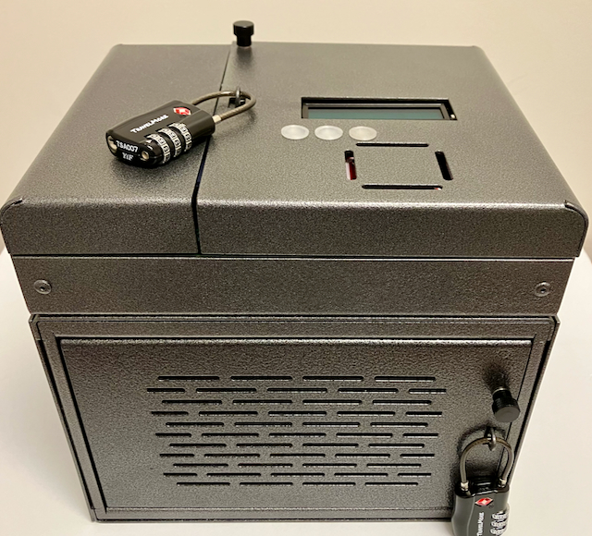
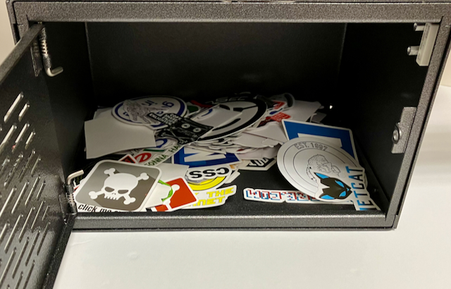
New - 2024 System

Slide 19
The Sticker Heist Scenario

Slide 20
Scenario
In the not-too-distant future, laptop stickers are the new global currency, and you've just gotten your hands on a safe full of them. The safe is locked for now, but its security system is no match for your team's hacking skills.

Slide 21
Scenario - Mission
Hack into the security system, disable the alarms, and pull off the heist.
Can you pull off the Sticker Heist?

Slide 22
Scenario - Objective
Find a way to get through the locks and disable the security protecting these valuable stickers.
Success allows each team member to choose and keep a few stickers.
This is a mission of stealth. To avoid being caught, we need to follow a few rules...

Slide 23
Scenario - Rules
You can not unplug power (this will set off alarms at Sticker HQ) or power off any individual systems.
No resetting the alarm system.
No destruction of any system components (i.e., clipping wires, rewiring, removing); again, this will set off alarms at HQ. Remember, stealth is key!
No physical modification of any hardware.

Slide 24
Pentesting
Objective sets a scope of work.
What system(s) are part of the job.
Rules sets a rules of engagement.
ROE very common in a pentesting engagement.

Slide 25
The Sticker Heist Hardware

Slide 26
Components
The box/safe.
Printed Circuit Board (PCB)
Display
RFID
LEDs
Arduino UNO R3
Raspberry Pi 4 (4 GB) with OLED display
Wiring for OFF button and alarm sensor

Slide 27
The Sticker Heist Software

Slide 28
Software
Raspbian OS
Custom configured
WIFI (NOTE! IT does NOT connect to any external networks)
Web Server
FTP Server
SSH and VNC
Arduino IDE and command line tools.
Python: stats.py to drive the OLED, shutdown-press-simple.py for the power off
Arduino code
Installed on the Raspberry Pi.
Complies and loads on boot. (Shell script: unoload.sh)

Slide 29
Canvas

Slide 30
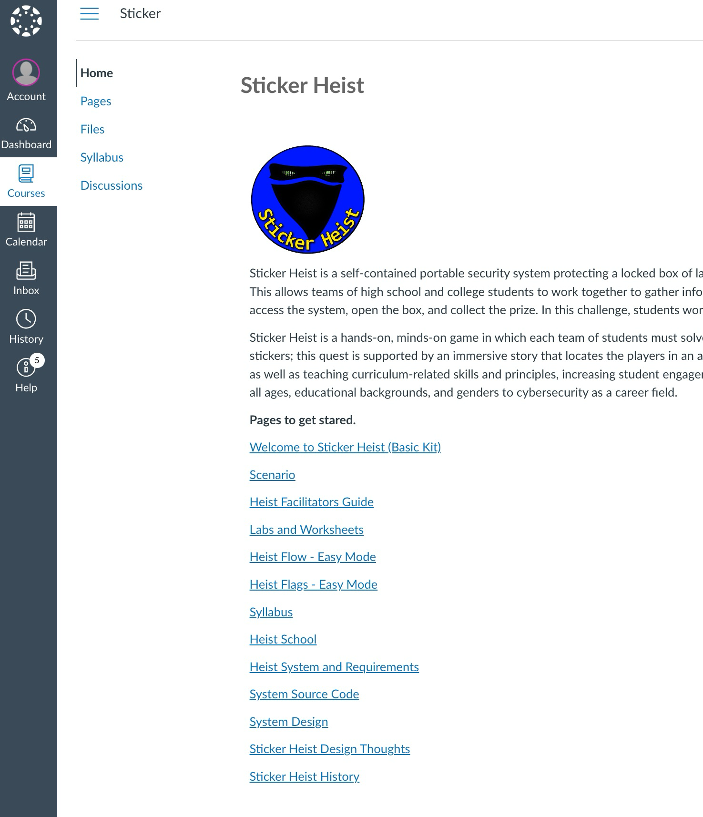
Canvas

Slide 31
Canvas
Each instructor will get access to the Canvas site.
Site has:
Facilitators Guide
Lab Documents
Presentations
Heist flow-chart and answers
All source code and libraries
Backup of all Operating Systems (Easy, Medium and Hard)
Other supporting information and material

Slide 32
Heist Facilitators Guide
Guide to help you run a heist.
Scenario, recommendations and tips.
The answer key for Easy, Medium and Hard mode.

Slide 33
Worksheets and Labs
Lab Worksheets can help guide the participants.
Give hints on next steps
Add graded tasks that map to course syllabus and industry standards.
Students create own vulnerability listing and ranking (scoring with industry CVSS score).
Students create security policies on how to secure their findings.

Slide 34
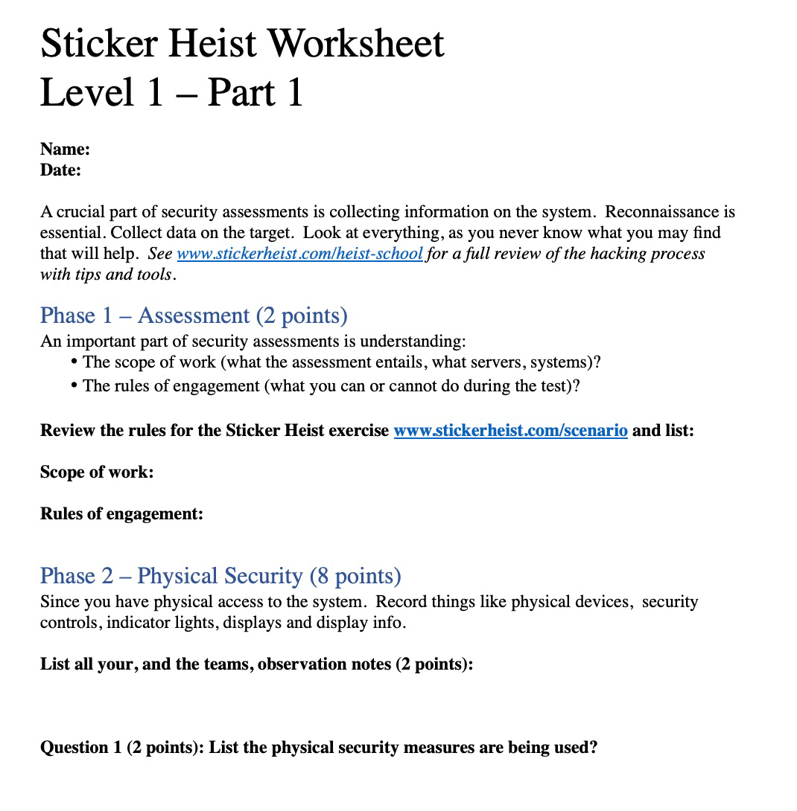
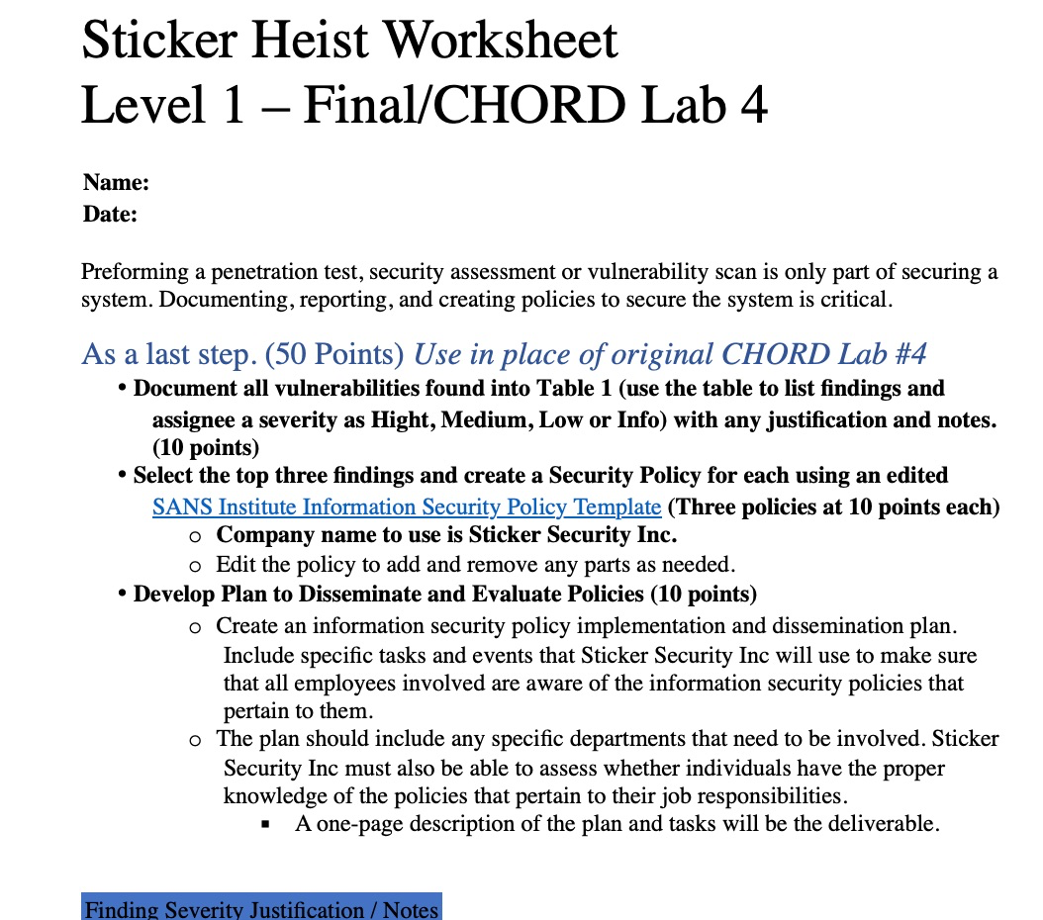
Worksheets

Slide 35
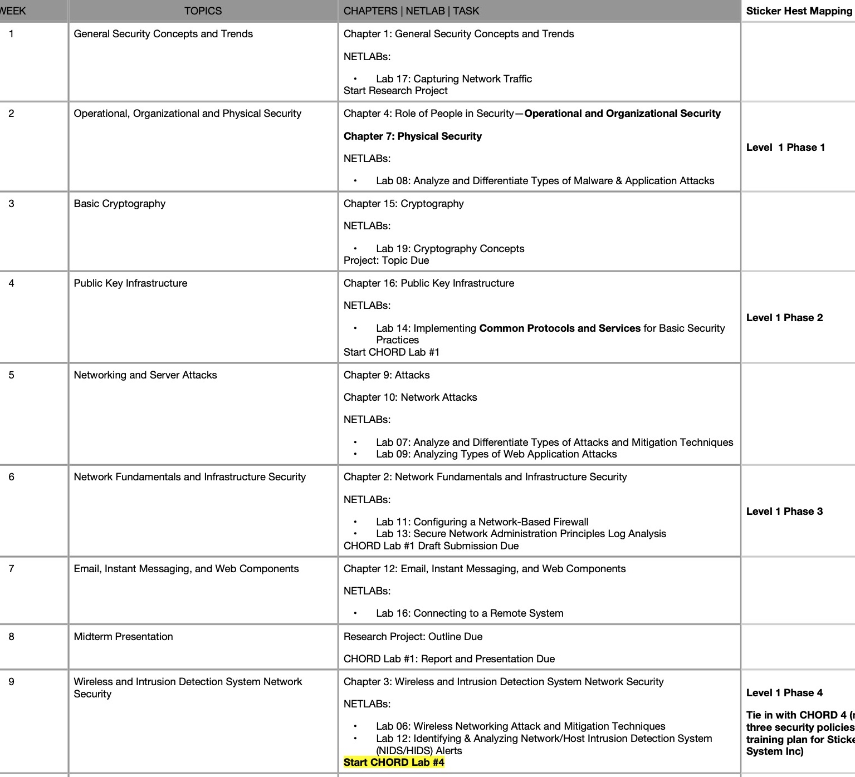
Mapping to Security + Course
Week

Slide 36
NIST / NICE Framework
The NICE Workforce Framework for Cybersecurity (NICE Framework) … provides a set of building blocks for describing the tasks, knowledge, and skills that are needed to perform cybersecurity work performed by individuals and teams.

Slide 37
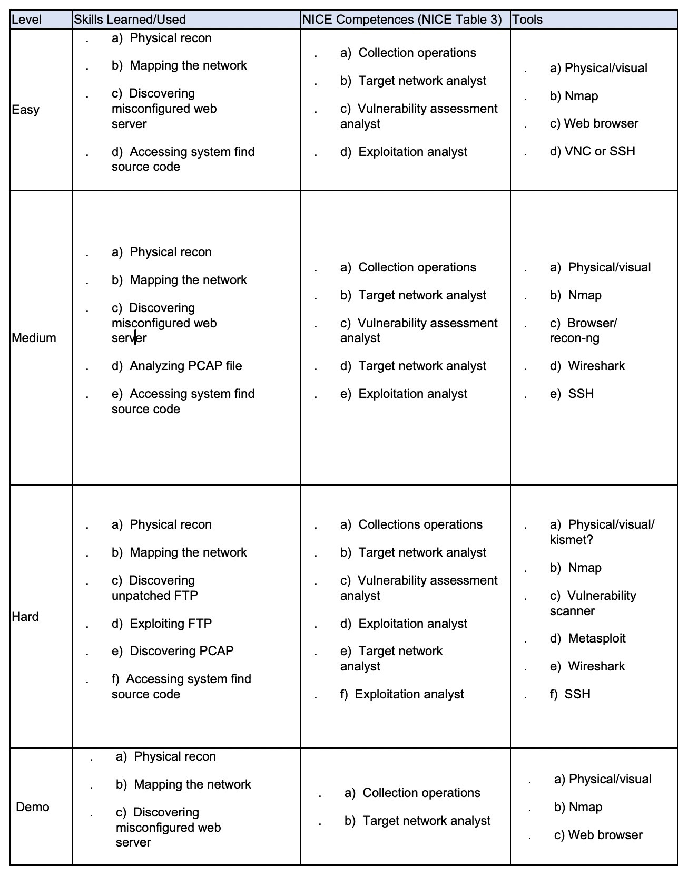
NIST/NICE Mapping

Slide 38
Running the Heist

Slide 39
General
Start off with the scenario and rules.
Break larger class into groups of four to five.
It can be cooperative or competitive.
The facilitator is the most important part of running the heist.
They know:
The class experience levels (empower the power students)
Time per exercise and total number of heist sessions
What labs you plan to use (if any)
They can drop hints to help move it along.

Slide 40
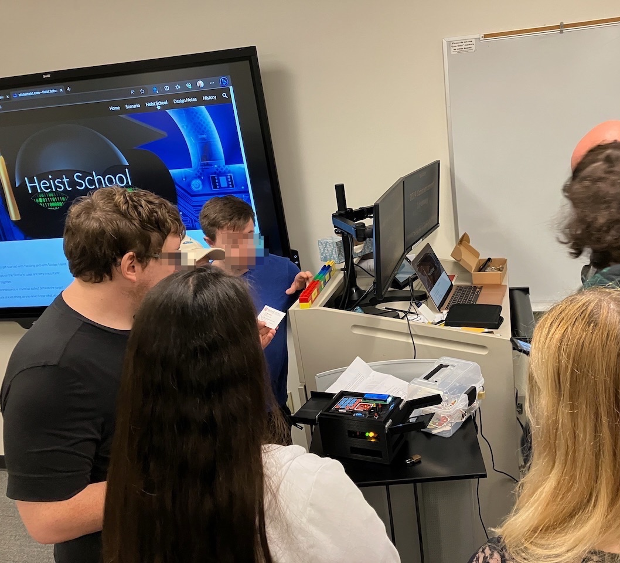
Heist Steps
Physical
Network
Application
Code

Slide 41
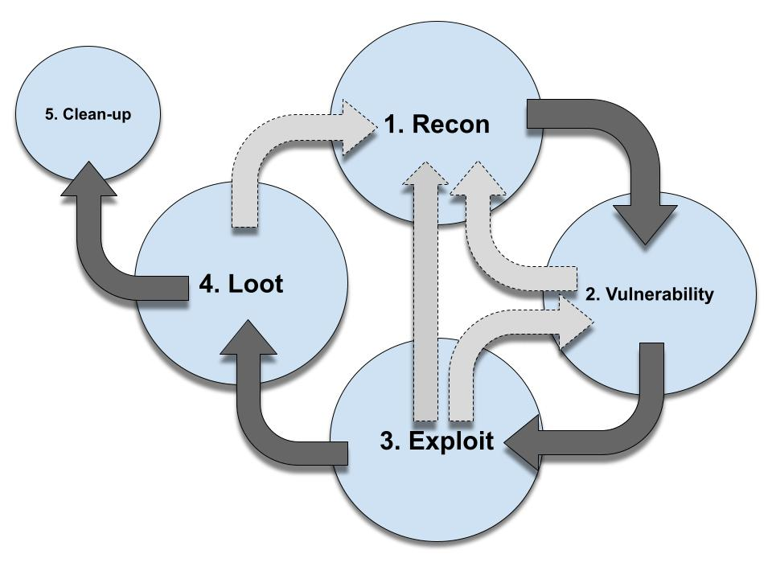
Using Common Pentesting Workflow

Slide 42
Heist Steps

Slide 43
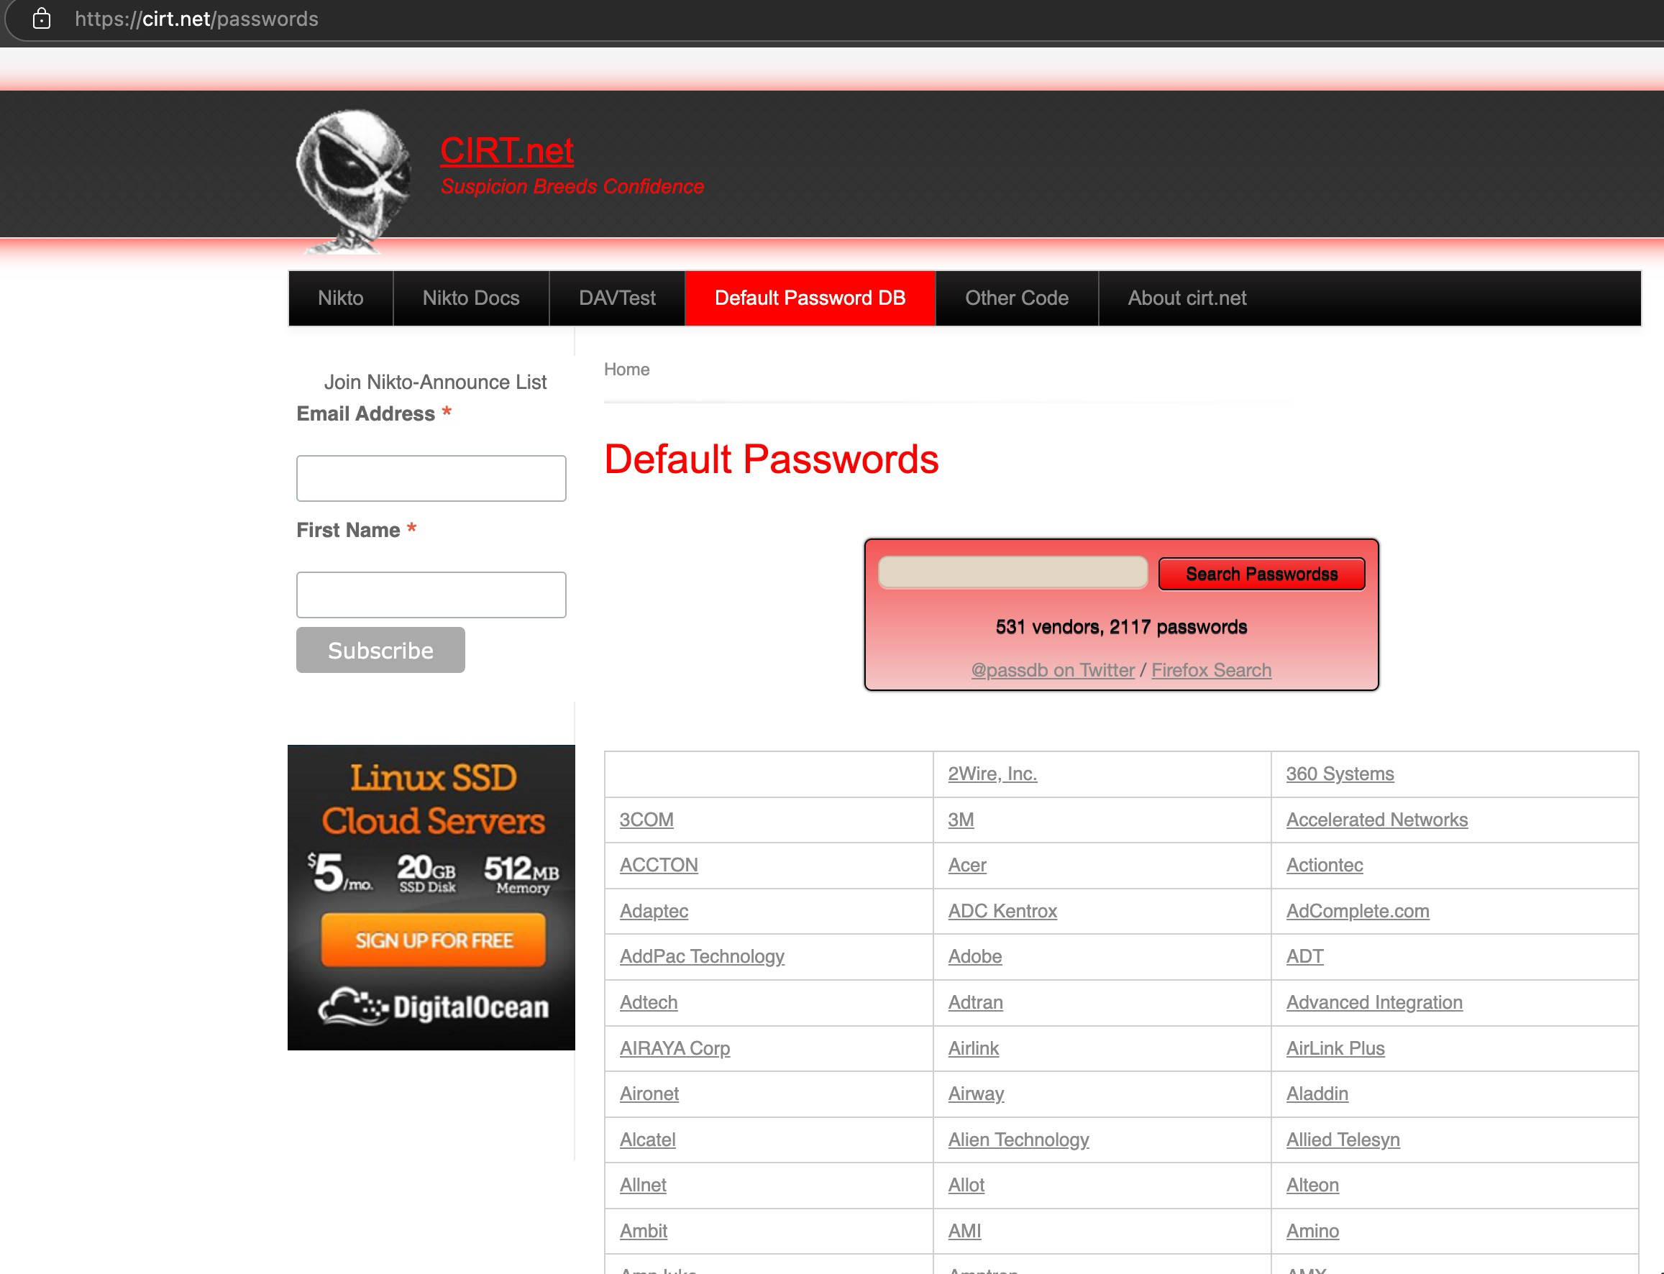
Default Password / Passcode

Slide 44
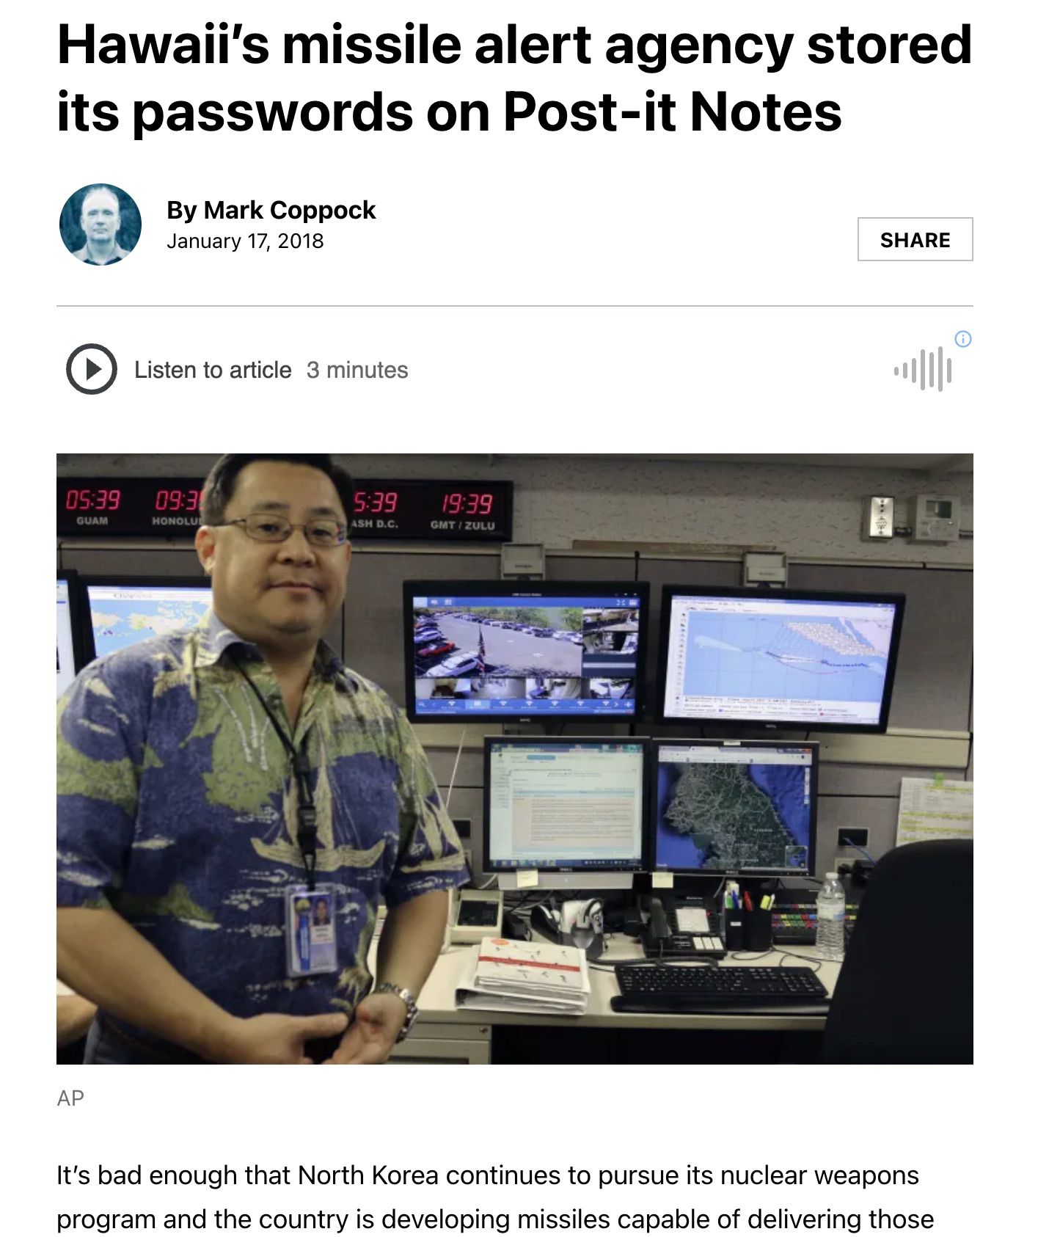
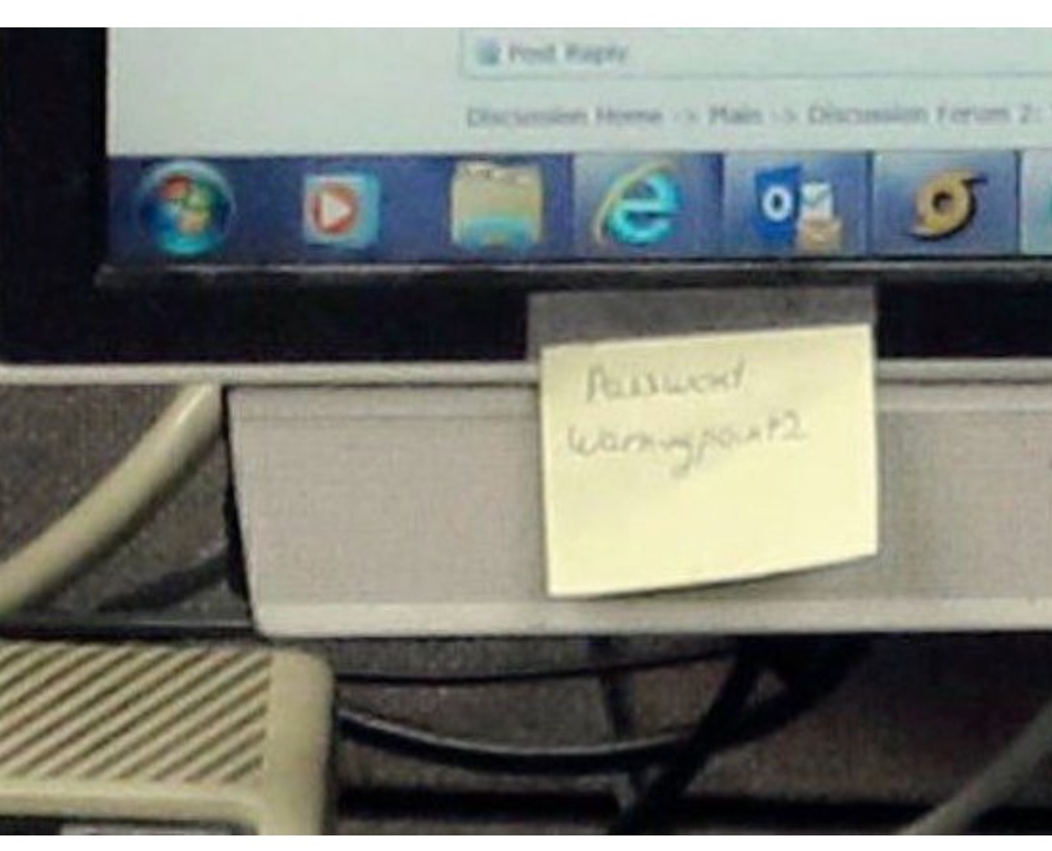
Written Down / Exposed Password

Slide 45
Vulnerabilities
We can introduce best practices and industry guideline (NIST, CISA, OWASP, SANS). Example:
Risks of Default Passwords on the Internet | CISA
Insecure Passwords and Default Credentials | OWASP Foundation
A05 Security Misconfiguration - OWASP Top 10:2021
A04 Insecure Design - OWASP Top 10:2021
NIST IoT IR 8259A, IoT Device Cybersecurity Capability Core Baseline | CSRC (nist.gov)

Slide 46
Demo

Slide 47
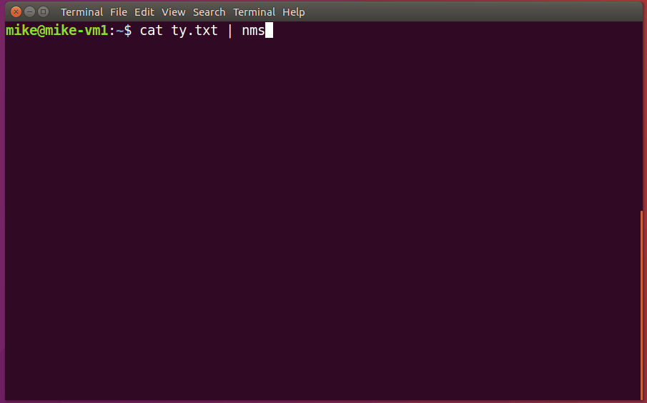
Thank You

Slide 48
October Threat Briefing

Slide 49
October Threat Briefing
Zero-click Windows TCP/IP RCE impacts all systems with IPv6 enabled, patch now (bleepingcomputer.com)
NIST releases first encryption tools to resist quantum computing (bleepingcomputer.com)

Slide 50
October Threat Briefing
SolarWinds fixes critical RCE bug affecting all Web Help Desk versions (bleepingcomputer.com)
Internal network, internet outage disrupts City of Flint's online services - Flint Beat

Slide 51
October Threat Briefing
Kentucky county’s clerk’s office breached in RansomHub attack | SC Media (scmagazine.com)

Slide 52
Information
Feel free to email us at Admin@gocybercollective.org.
If you have a suggestion on meeting topics, special interest groups, breakfast menu, or anything else we want to hear from you.
You can register and download past presentations from the website.
GoCyberCollective.org

Slide 53
Event Sponsors

Slide 54
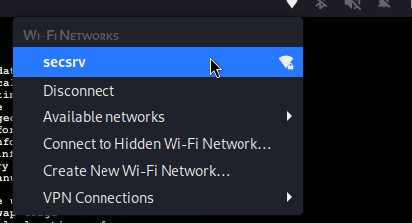
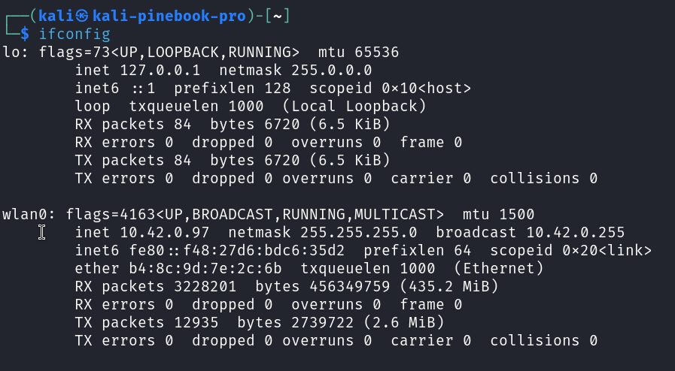
Get on Network
Using found credentials
Demonstrates importance of basic networking skills

Slide 55
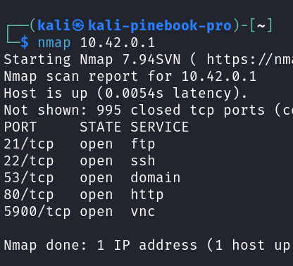
Map the server
Open ports
Port 80 (Web server)

Slide 56
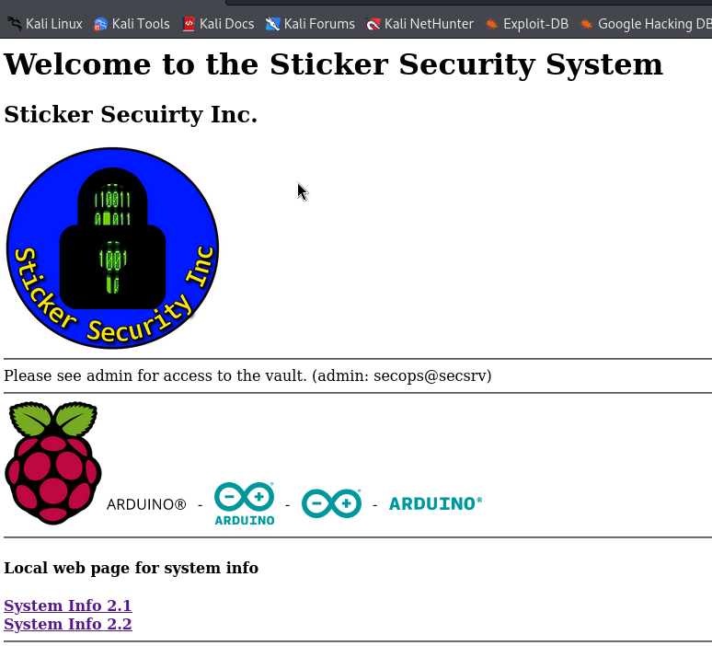
Web Page
Gather more info here.
Username
Hardware
Link to info (version #)

Slide 57
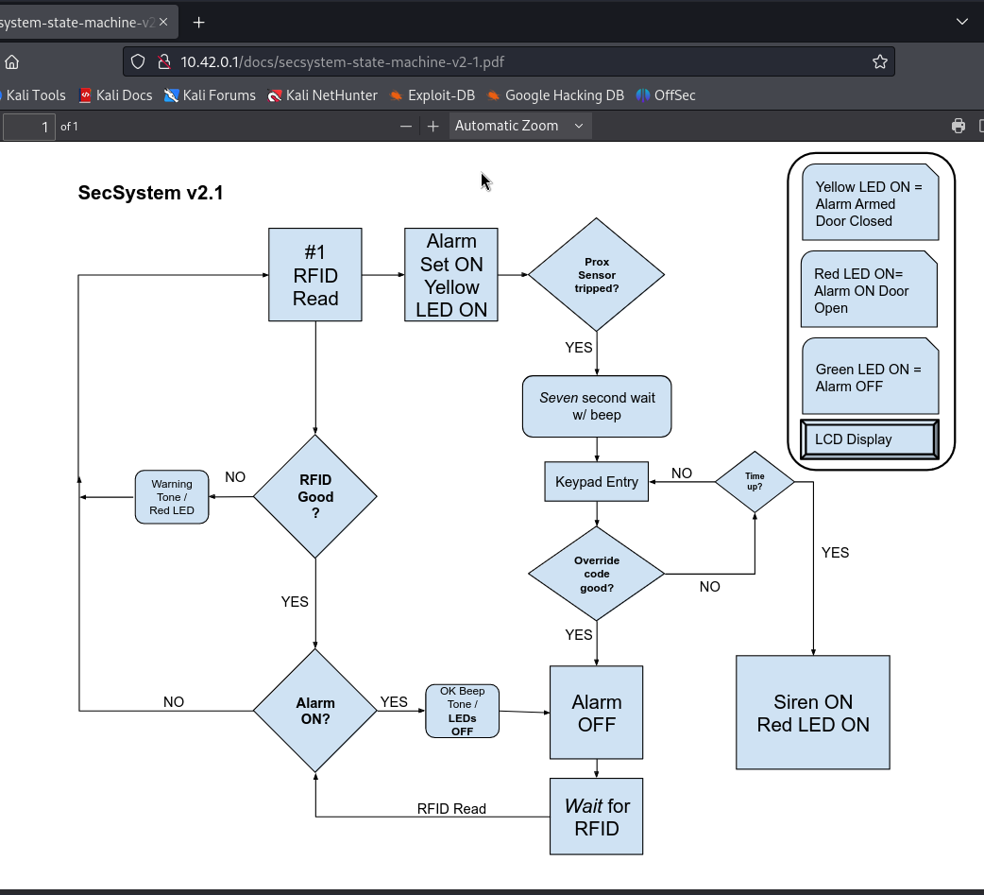
PDF Linked
How the system works.
Override code needed

Slide 58
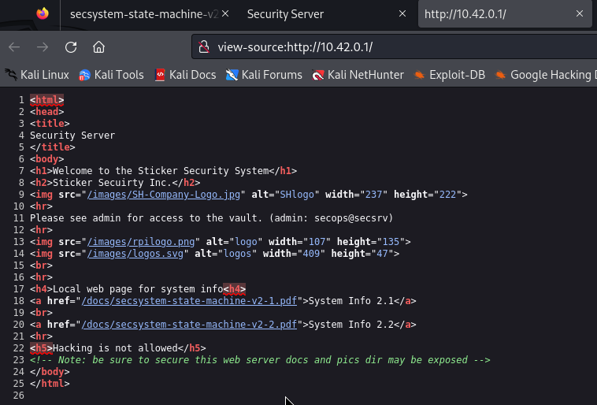
Page Source
Comment on exposed directory

Slide 59
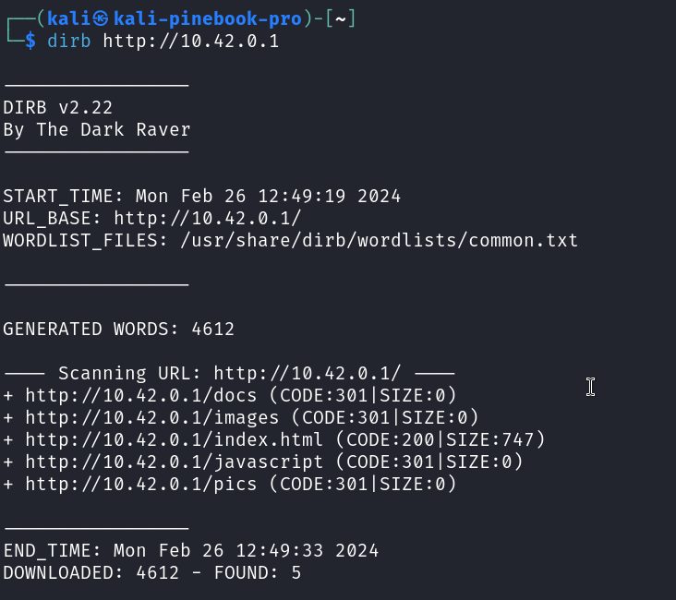
Test Web Server
Use a tool
Manipulate the URL

Slide 60
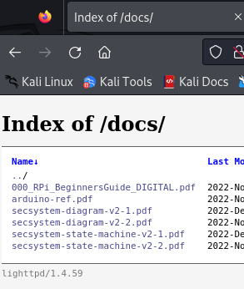
Docs Exposed
More documents to recon
Example of misconfigured server (an OWSP Top 10)

Slide 61
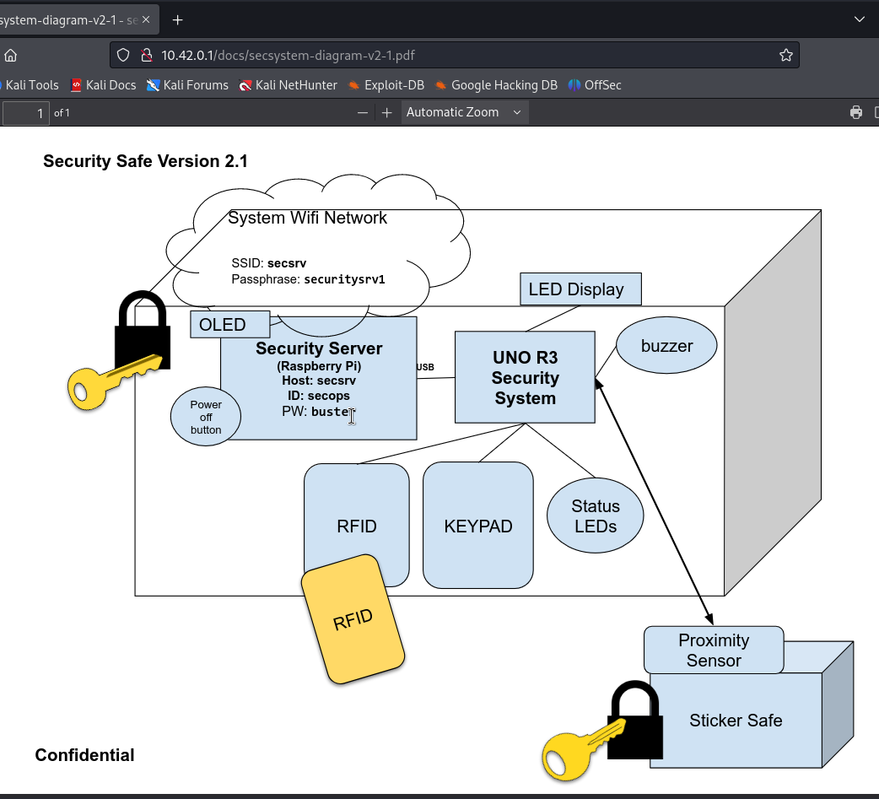
Confidential PDF
System password

Slide 62
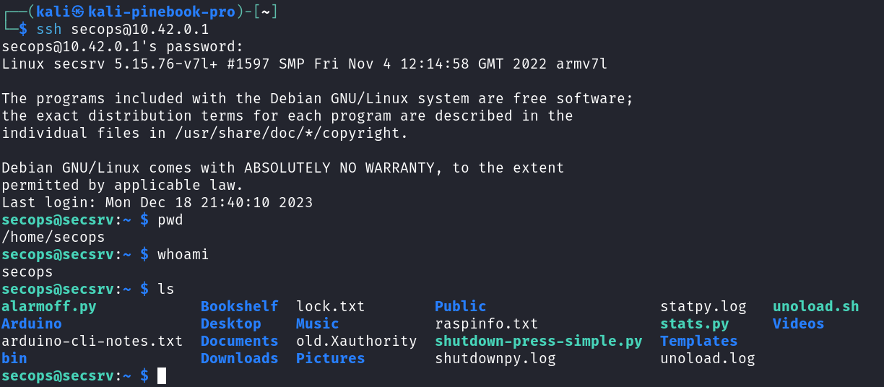
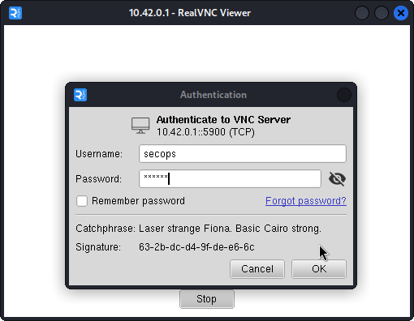
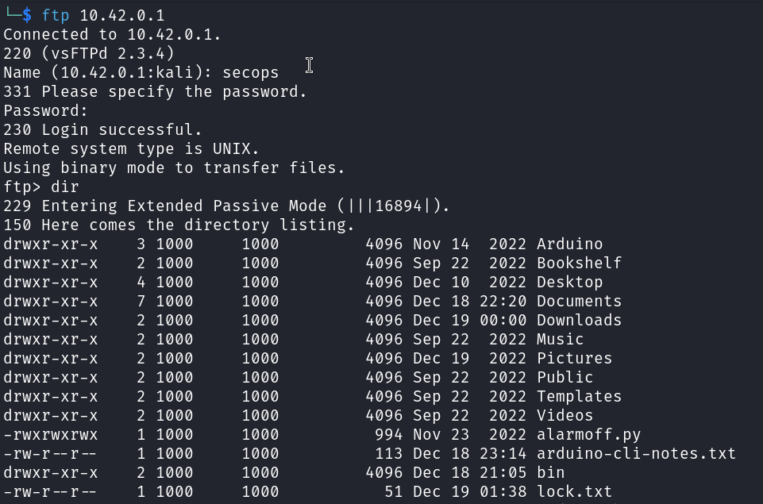
System Access
Can use:
SSH
VNC
FTP

Slide 63
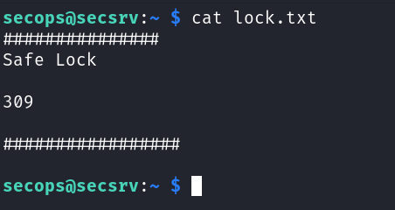
Recon Files
Find:
Safe Lock
Source Code

Slide 64
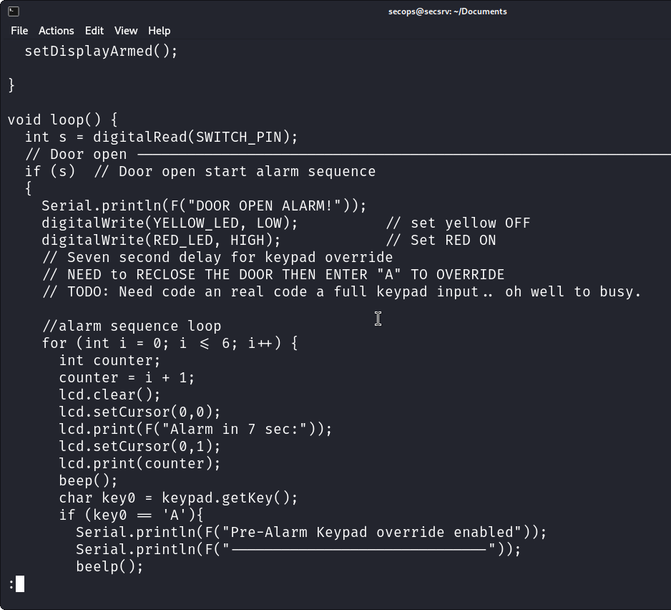
Source Code
Comments on how to override the alarm

Slide 65
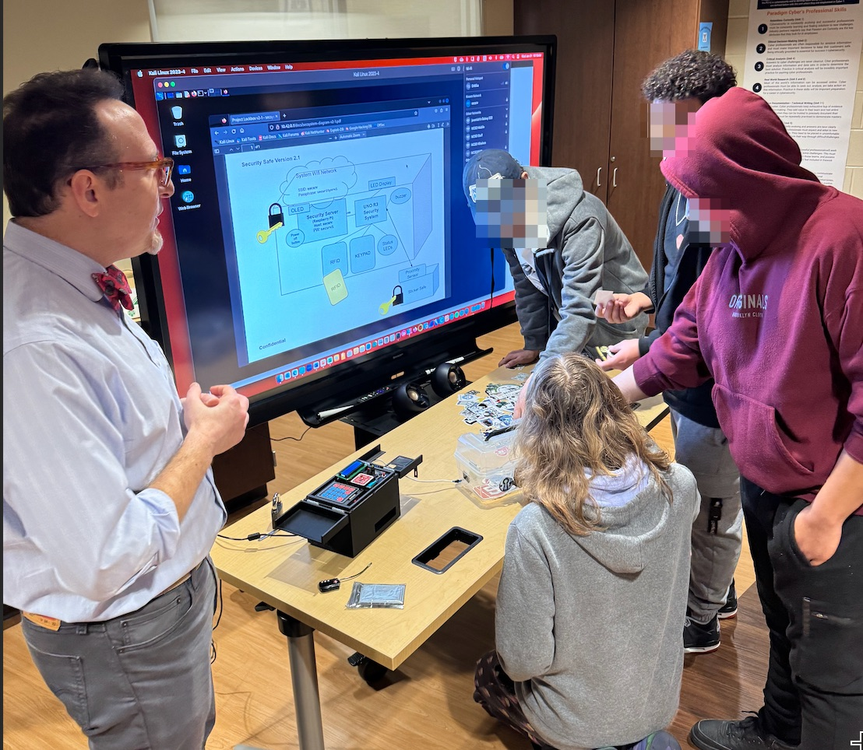
Heist Complete
Get the loot.

